Slide 1
25
Other Topics

Slide 2
What's in a name? that which we call a rose
By any other name would smell as sweet.
  William Shakespeare
O Diamond! Diamond! thou little knowest the mischief done!
  Sir Isaac Newton

Slide 3
OBJECTIVES
In this chapter you’ll learn:
To use const_cast to temporarily treat a const object as a non-const object.
To use namespaces.
To use operator keywords.
To use mutable members in const objects.
To use class-member pointer operators .* and ->*.
To use multiple inheritance.
The role of virtual base classes in multiple inheritance.

Slide 4
25.1 Introduction
25.2 const_cast Operator
25.3 namespaces
25.4 Operator Keywords
25.5 mutable Class Members
25.6 Pointers to Class Members (.* and ->*)
25.7 Multiple Inheritance
25.8 Multiple Inheritance and virtual Base Classes
25.9 Wrap-Up

Slide 5
25.1 Introduction
Advanced C++ features
  const_cast operator
    Allows programmers to add or remove const qualifications
  namespaces
    Used to ensure that every identifier has a unique name
    Resolve naming conflicts among multiple libraries
  Operator keywords
    Useful for keyboards that do not support certain characters

Slide 6
25.1 Introduction (Cont.)
Advanced C++ features (Cont.)
  mutable storage-class specifier
    Indicates a data member should always be modifiable
      Even inside a const object
  Pointer to class member operators
  Multiple inheritance
    A derived class inherits from several base classes
    virtual inheritance solves potential problems

Slide 7
25.2 const_cast Operator
volatile qualifier
  Applied to a variable when it is expected to be modified by hardware or other programs
    Indicates that compiler should not optimize this variable
const_cast operator
  Casts away const or volatile qualifications
    In case of const, the variable can now be modified
  Dangerous, but useful in certain situations
    Older C and C++ library functions have non-const parameters but do not actually modify them
    A function could return const data that the programmer knows was originally and should now be non-const

Slide 8
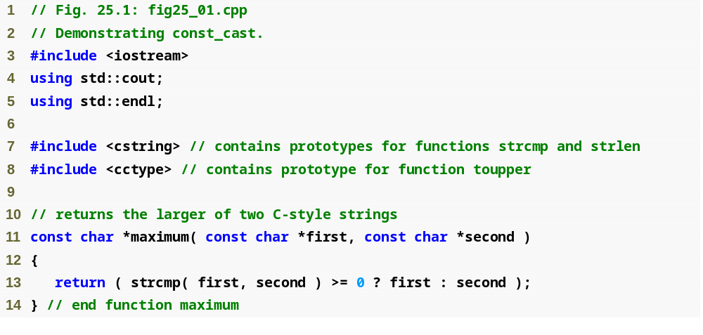
Outline
fig25_01.cpp
(1 of 2)
Function maximum takes two const char * parameters and returns a const char *

Slide 9
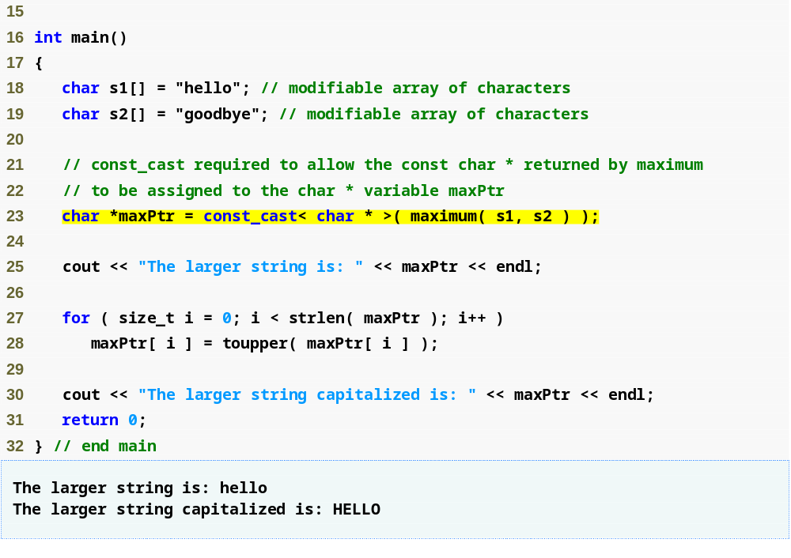
Outline
fig25_01.cpp
(2 of 2)
Cast away the const-ness of the pointer returned by maximum

Slide 10
Error-Prevention Tip 25.1
In general, a const_cast should be used only when it is known in advance that the original data is not constant. Otherwise, unexpected results may occur.

Slide 11
25.3 namespaces
A namespace
  Defines scope in which identifiers and variables are placed
    Namespace members
  Qualifying a namespace member’s name
    Precede it with the namespace name and the binary scope resolution operator (::)
      Example
        MyNameSpace::member

Slide 12
Good Programming Practice 25.1
Avoid identifiers that begin with the underscore character, as these can lead to linker errors. Many code libraries use names that begin with underscores.

Slide 13
25.3 namespaces (Cont.)
A namespace (Cont.)
  using directives
    Automatically qualifies all members in a namespace
    Must appear before the names are used in the program
    Example
      using namespace MyNameSpace;
        Members of namespace MyNameSpace can be used without needing to be qualified
  using declarations
    Automatically qualifies one member of a namespace
    Example
      using std::cout;
        Brings std::cout into the current scope

Slide 14
Software Engineering Observation 25.1
Ideally, in large programs, every entity should be declared in a class, function, block or namespace. This helps clarify every entity’s role.

Slide 15
Error-Prevention Tip 25.2
Precede a member with its namespace name and the scope resolution operator (::) if the possibility exists of a naming conflict.

Slide 16
25.3 namespaces (Cont.)
Defining namespaces
  Keyword namespace
  A namespace name
    Can be an unnamed namespace
      Unnamed namespaces have implicit using directives
  Body of a namespace is delimited by braces ({})
  May be defined at global scope or nested within another namespace
Namespace aliases
  Example
    Namespace CPPHTP = CPlusPlusHowToProgram;
      CPPHTP is an alias for CPlusPlusHowToProgram

Slide 17
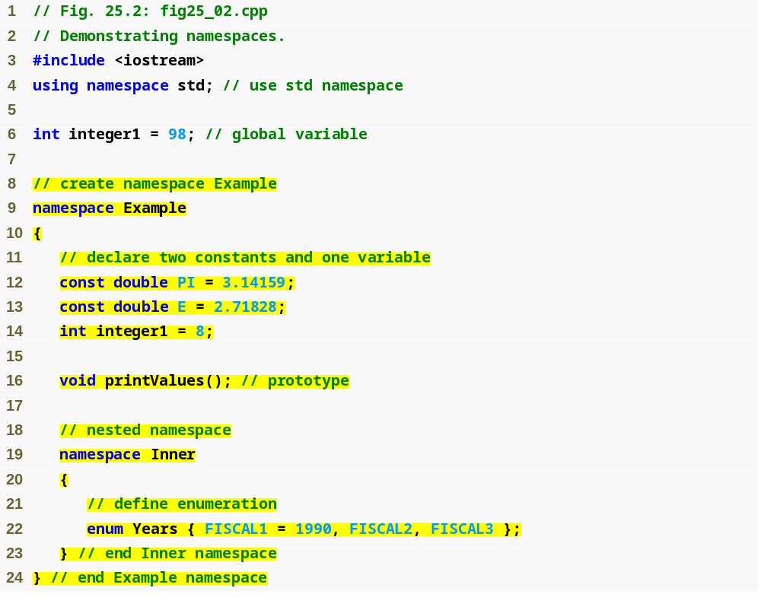
Inform the compiler that namespace std is being used
Outline
fig25_02.cpp
(1 of 3)
Define namespace Example
Define variables in namespace Example
Declare a function prototype in namespace Example
Define nested namespace Inner

Slide 18
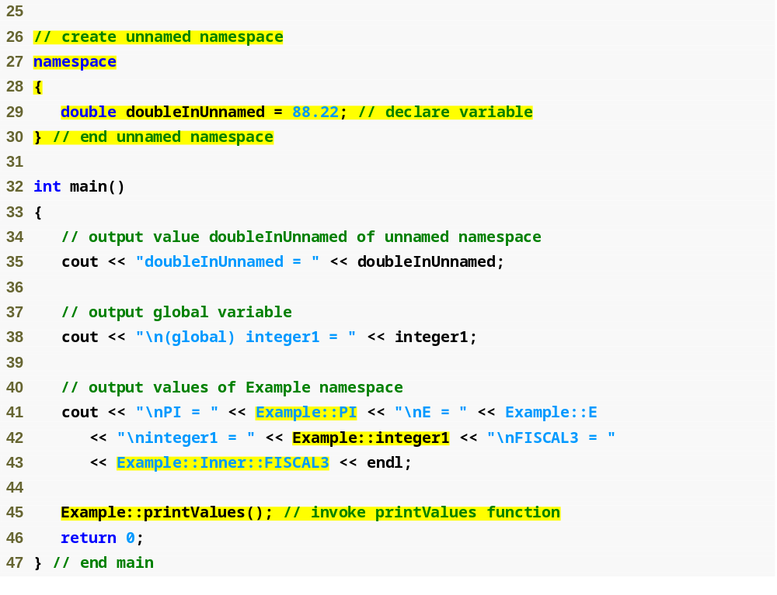
Define an unnamed namespace
Outline
fig25_02.cpp
(2 of 3)
doubleInUnnamed is in an unnamed namespace and does not need to be qualified
Output the value of global variable integer1
Qualify variables that are namespace members

Slide 19
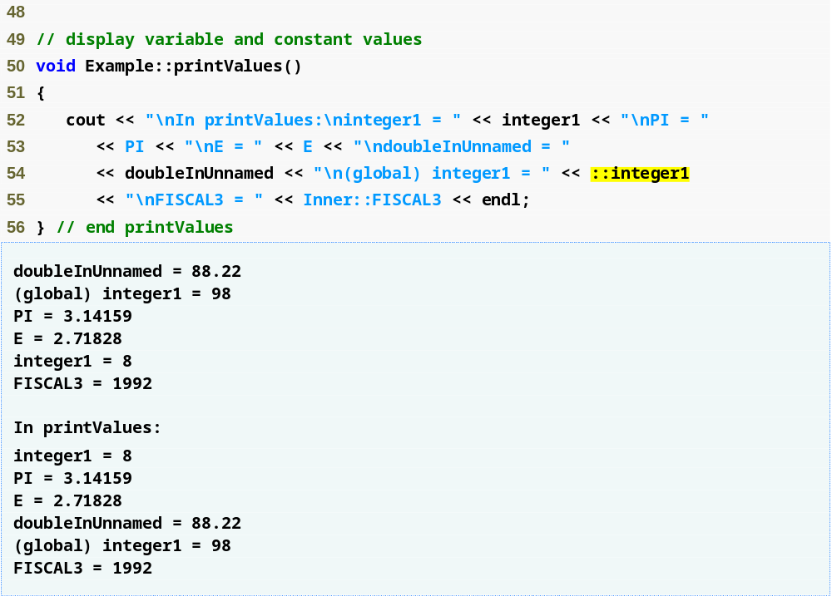
Function printValues of namespace Example can access other members of Example directly
Outline
fig25_02.cpp
(3 of 3)
Use the unary scope resolution operator to access global variable integer1

Slide 20
Software Engineering Observation 25.2
Each separate compilation unit has its own unique unnamed namespace; i.e., the unnamed namespace replaces the static linkage specifier.

Slide 21
Common Programming Error 25.1
Placing main in a namespace is a compilation error.

Slide 22
25.4 Operator Keywords
Operator keywords
  Can be used in place of several C++ operators
  Useful for keyboards that do not support certain characters
  Requirements for using operator keywords
    Microsoft Visual C++ requires header file <iso646.h>
    GNU C++ requires compiler option –foperator-names
    Recent versions of Borland C++ implicitly permit these keywords

Slide 23
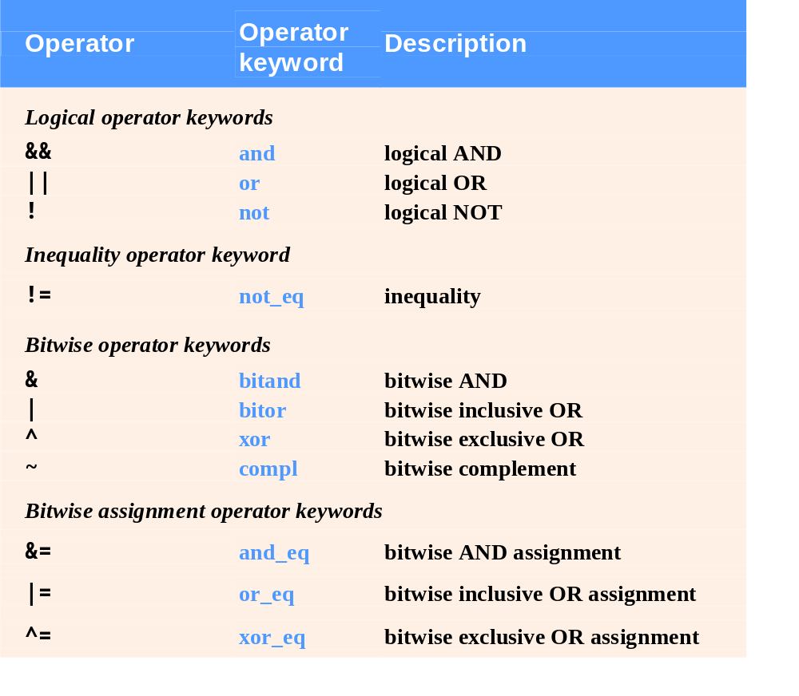
Fig. 25.3 | Operator keyword alternatives to operator symbols.

Slide 24
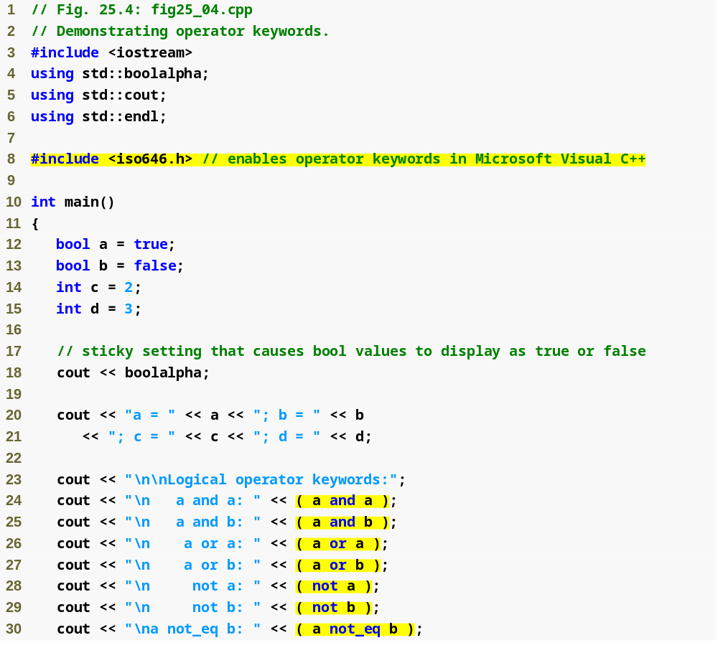
Outline
fig25_04.cpp
(1 of 2)
Use the various logical operator keywords

Slide 25
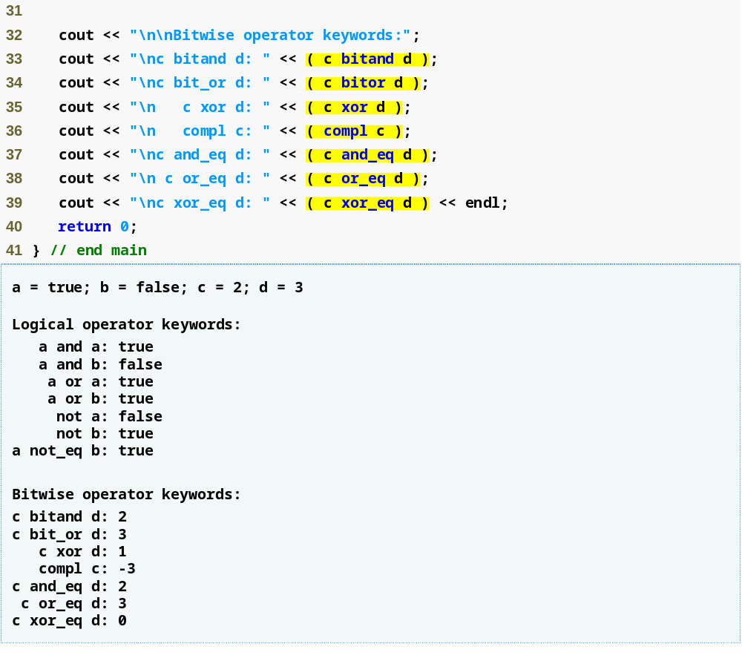
Outline
Use the various bitwise operator keywords
fig25_04.cpp
(2 of 2)

Slide 26
25.5 mutable Class Members
Storage class specifier mutable
  Specifies that a data member can always be modified
    Even in a const member function or const object
  Reduces the need to cast away “const-ness”

Slide 27
Portability Tip 25.1
The effect of attempting to modify an object that was defined as constant, regardless of whether that modification was made possible by a const_cast or C-style cast, varies among compilers.

Slide 28
Software Engineering Observation 25.3
mutable members are useful in classes that have “secret” implementation details that do not contribute to the logical value of an object.

Slide 29
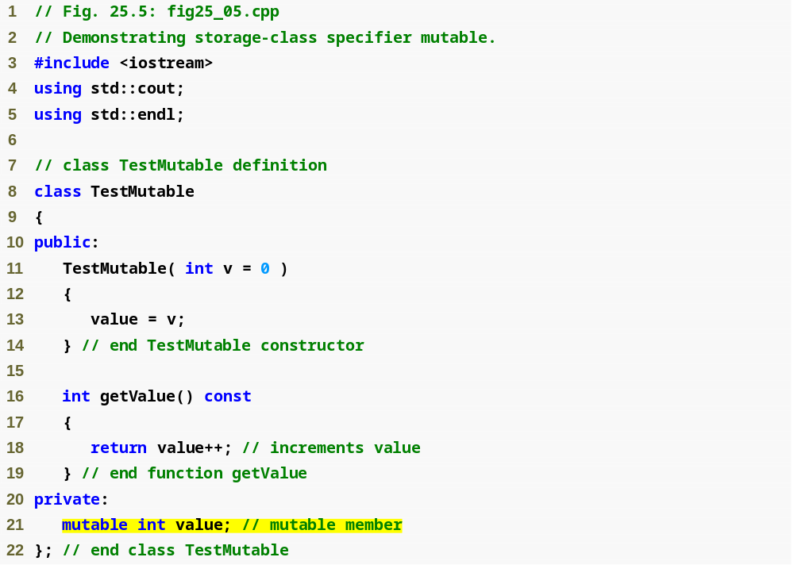
Outline
fig25_05.cpp
(1 of 2)
value can be modified inside a const member function because it is a mutable data member
Declare data member value as mutable

Slide 30
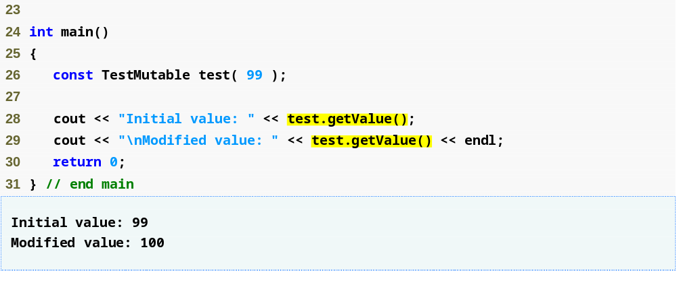
Outline
fig25_05.cpp
(2 of 2)

Slide 31
25.6 Pointers to Class Members (.* and ->*)
.* and ->* operators
  Used for accessing class members via pointers
    Client code can create pointers only to class members that are accessible to that client code
  Used primarily by advanced C++ programmers

Slide 32
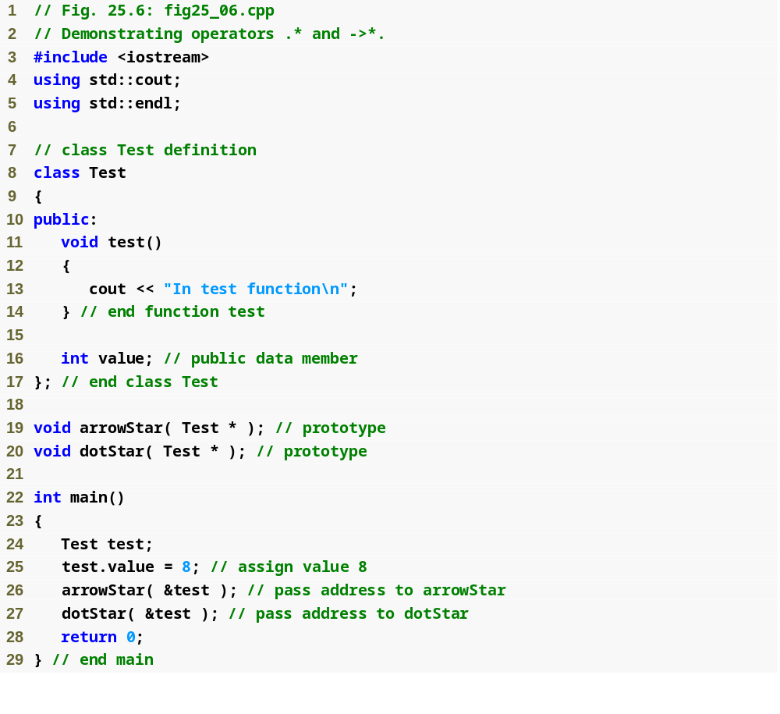
Outline
fig25_06.cpp
(1 of 2)
Call functions arrowStar and dotStar with the address of object test

Slide 33
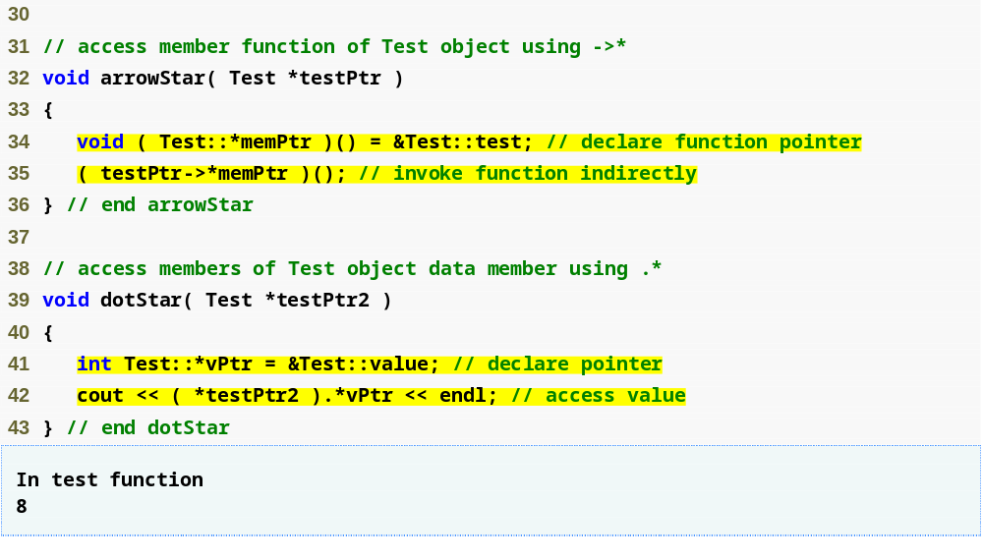
Initialize memPtr with the address of class Test’s member function named test
Declare memPtr as a pointer to a member function of Test that takes no parameters and returns void
Outline
fig25_06.cpp
(2 of 2)
Invoke the member function stored in memPtr (i.e., test) using the ->* operator
Declare vPtr as a pointer to an int data member of class Test
Initialize vPtr to the address of the data member value
Dereference testPtr2 and use the .* operator to access the member to which vPtr points

Slide 34
Common Programming Error 25.2
Declaring a member-function pointer without enclosing the pointer name in parentheses is a syntax error.

Slide 35
Common Programming Error 25.3
Declaring a member-function pointer without preceding the pointer name with a class name followed by the scope resolution operator (::) is a syntax error.

Slide 36
Common Programming Error 25.4
Attempting to use the -> or * operator with a pointer to a class member generates syntax errors.

Slide 37
25.7 Multiple Inheritance
Multiple Inheritance
  When a derived class inherits members from two or more base classes
    Provide comma-separated list of base classes after the colon following the derived class name
  Can cause ambiguity problems
    Should be used only by experienced programmers
    Newer languages do not allow multiple inheritance
    A common problem occurs if more than one base class contains a member with the same name
      Solved by using the binary scope resolution operator

Slide 38
Good Programming Practice 25.2
Multiple inheritance is a powerful capability when used properly. Multiple inheritance should be used when an “is a” relationship exists between a new type and two or more existing types (i.e., type A “is a” type B and type A “is a” type C).

Slide 39
Software Engineering Observation 25.4
Multiple inheritance can introduce complexity into a system. Great care is required in the design of a system to use multiple inheritance properly; it should not be used when single inheritance and/or composition will do the job.

Slide 40
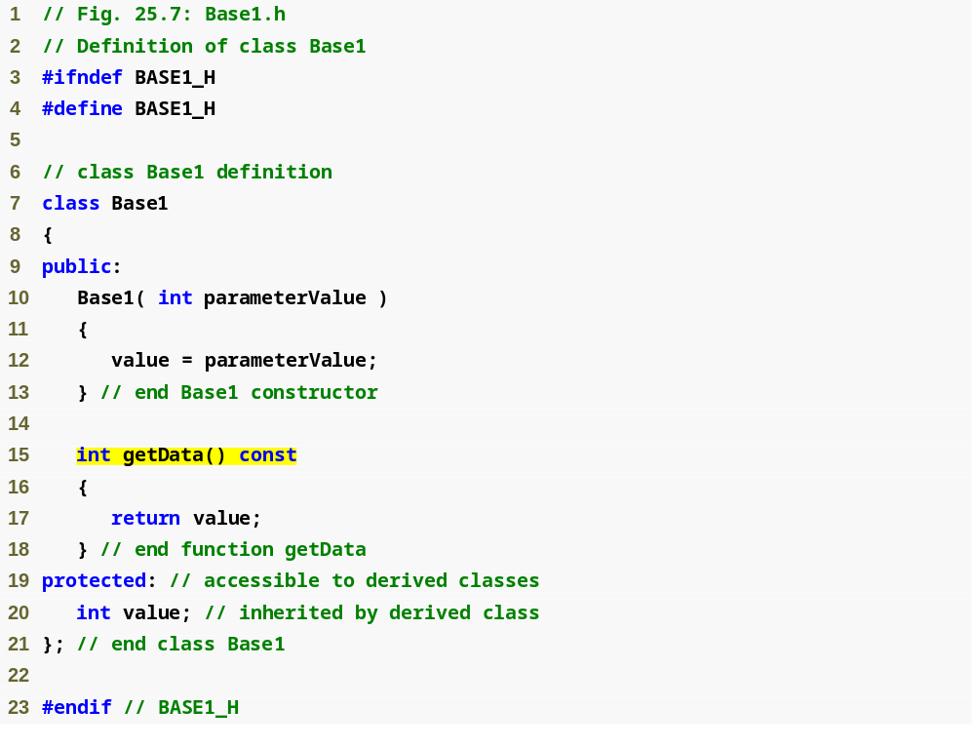
Outline
Base1.h
(1 of 1)
Class Base1 declares member function getData

Slide 41
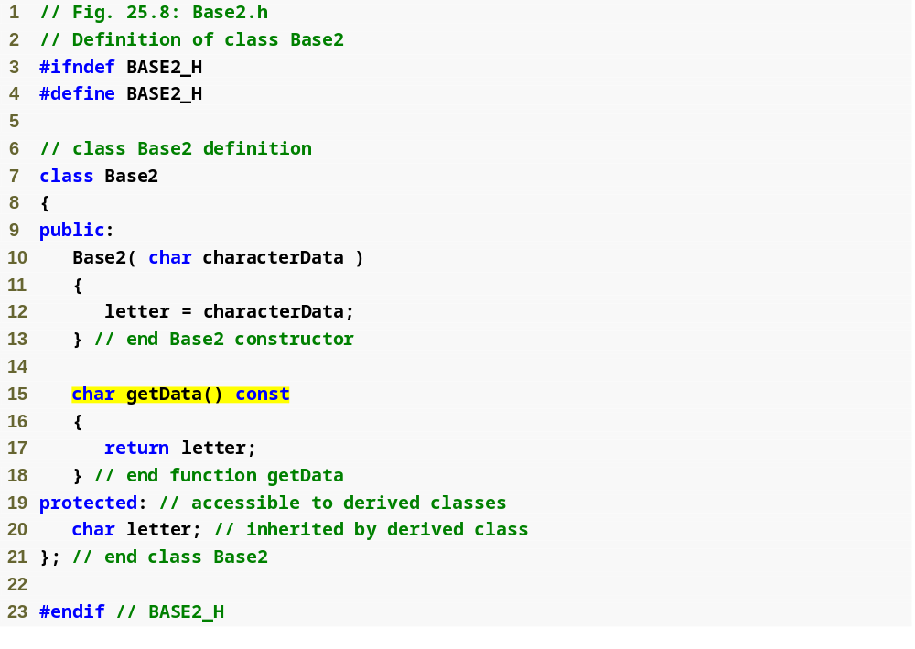
Outline
Base2.h
(1 of 1)
Class Base2 also declares member function getData

Slide 42
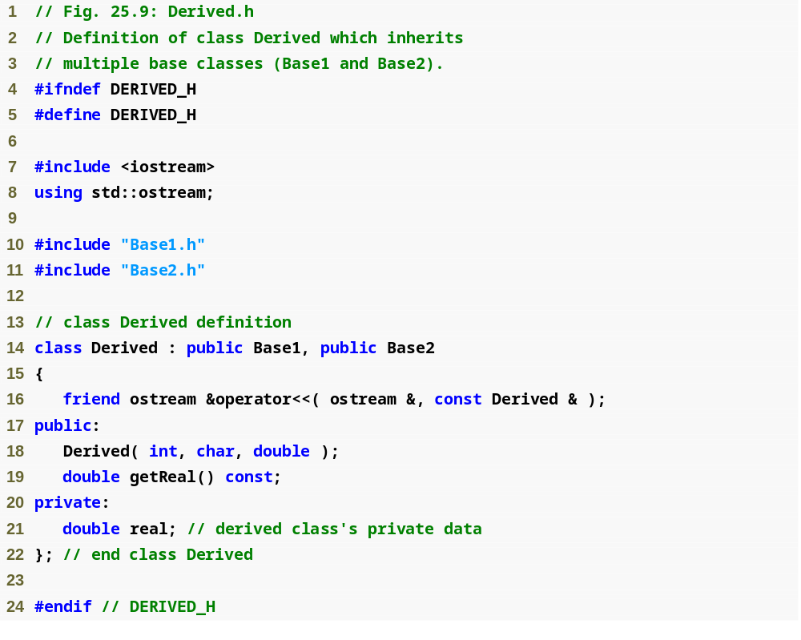
Outline
Derived.h
(1 of 1)
Class Derived inherits from both class Base1 and class Base2 through multiple inheritance

Slide 43
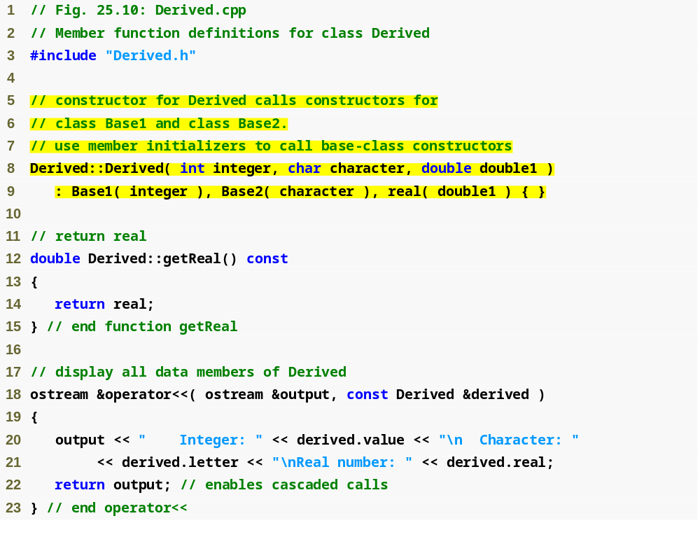
Outline
Derived.cpp
(1 of 1)
Base-class constructors are called in the order that the inheritance is specified

Slide 44
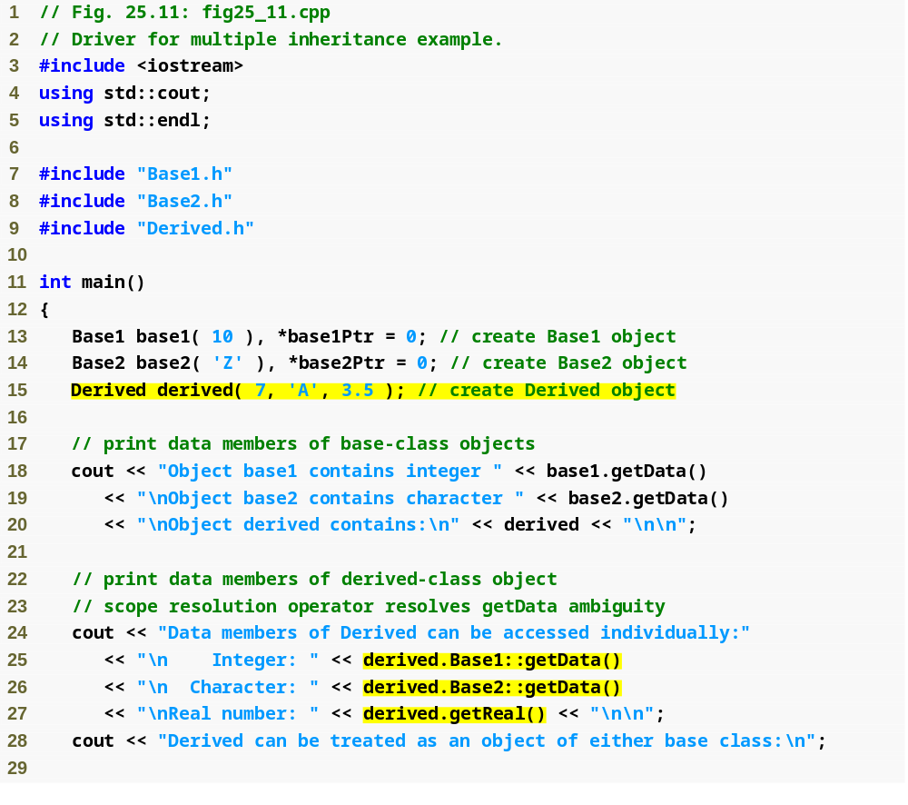
Outline
fig25_11.cpp
(1 of 2)
Get the value of the variable inherited from class Base1
Get the value of the variable inherited from class Base2

Slide 45
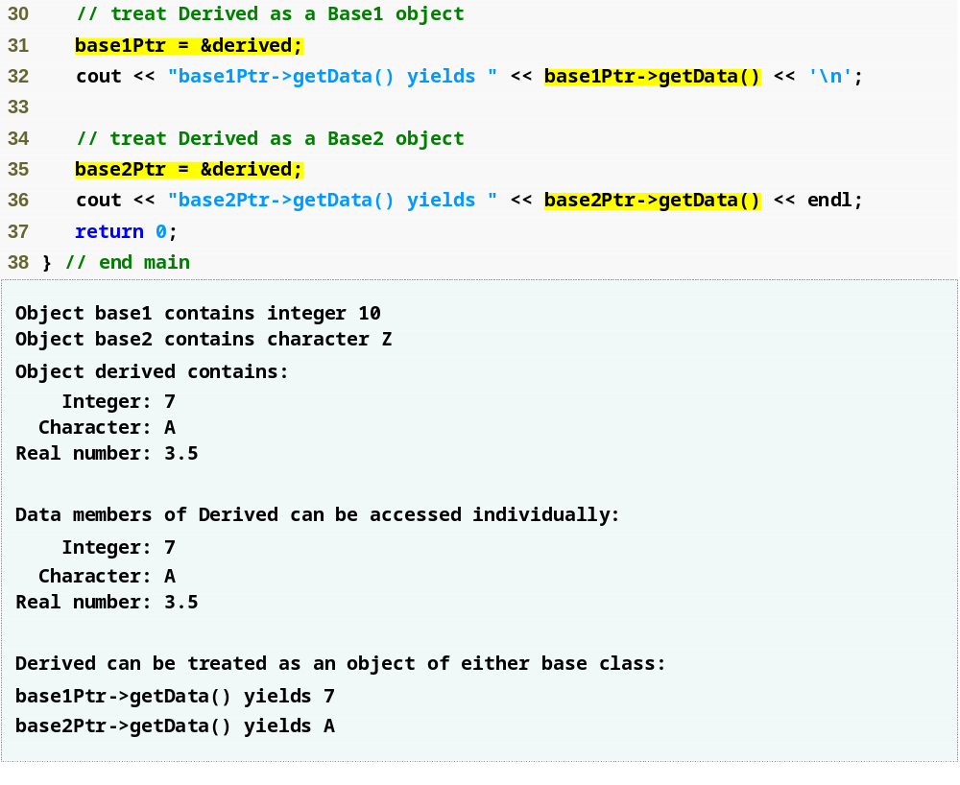
Outline
base1Ptr calls Base1’s getData member function
fig25_11.cpp
(2 of 2)
base2Ptr calls Base2’s getData member function

Slide 46
25.8 Multiple Inheritance and virtual Base Classes
Base-class subobject
  The members of a base class that are inherited into a derived class
Diamond inheritance
  When two classes inherit from the same base class, and another derived class inherits from both of those two classes, forming a diamond-like structure
  Example
    basic_istream and basic_ostream each inherit from basic_ios
    basic_iostream inherits from both basic_istream and basic_ostream

Slide 47

Fig. 25.12 | Multiple inheritance to form class basic_iostream.

Slide 48
25.8 Multiple Inheritance and virtual Base Classes (Cont.)
Diamond inheritance (Cont.)
  Ambiguity problem (from example)
    Class basic_iostream could contain two copies of the basic_ios subobject
      One inherited via basic_istream and one inherited via basic_ostream
      Compiler would not know which version to use

Slide 49
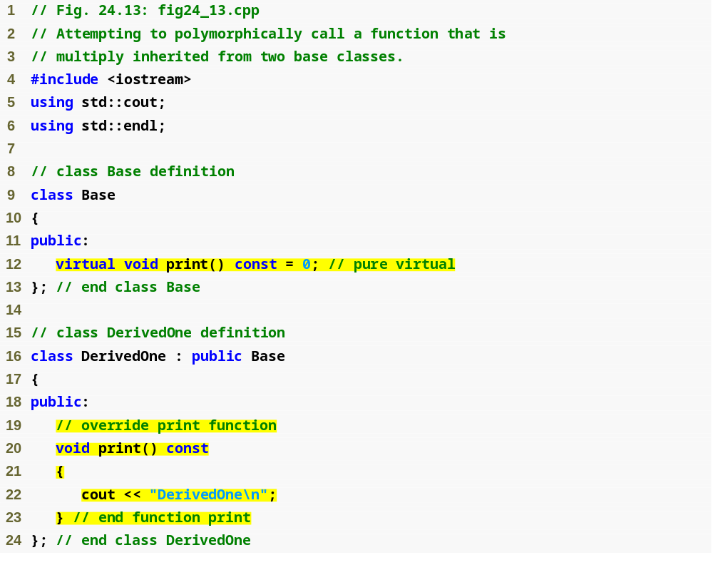
Outline
fig25_13.cpp
(1 of 3)
Base class Base contains pure virtual function print
Class DerivedOne inherits from class Base and overrides the print function

Slide 50
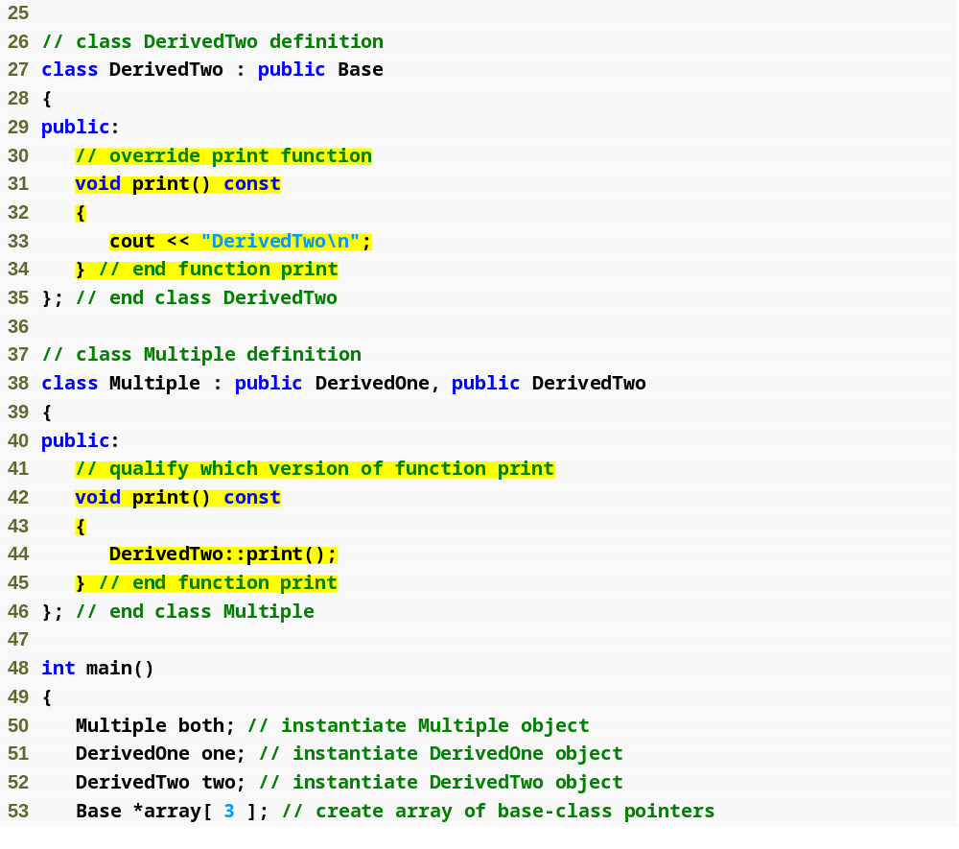
Class DerivedTwo inherits from class Base and overrides the print function
Outline
fig25_13.cpp
(2 of 3)
Class Multiple inherits from both classes DerivedOne and DerivedTwo
Multiple overrides function print to call DerivedTwo’s version of print

Slide 51
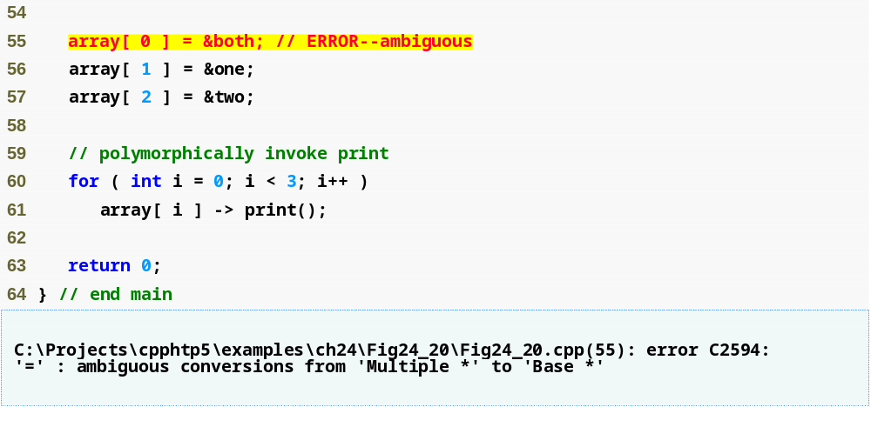
Outline
The compiler does not know which subobject in both the pointer array[ 0 ] should point to
fig25_13.cpp
(3 of 3)

Slide 52
25.8 Multiple Inheritance and virtual Base Classes (Cont.)
virtual base-class inheritance
  A base class can be inherited as virtual
    Only one subobject will appear in the derived class
    If the virtual base class’s constructor requires arguments, the most derived class must explicitly invoke that constructor

Slide 53
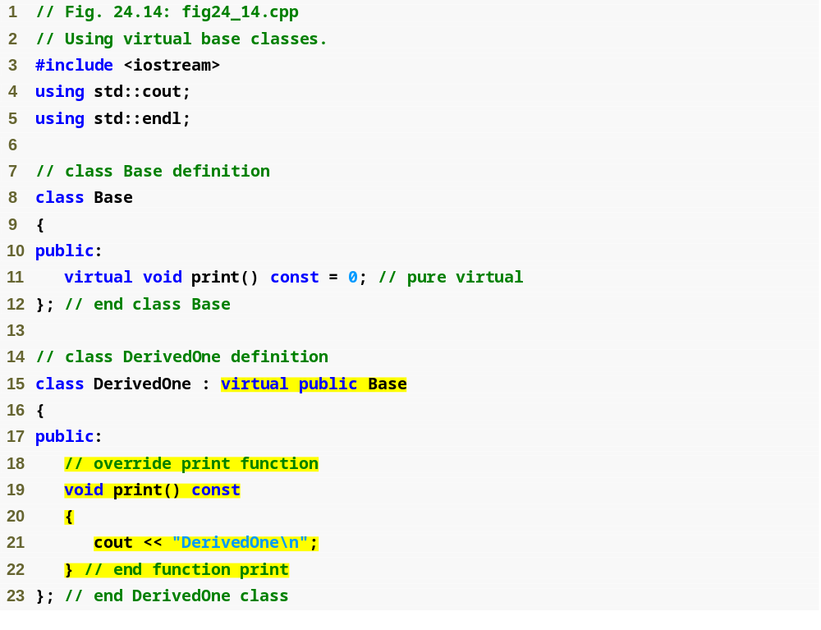
Outline
fig25_14.cpp
(1 of 3)
Class DerivedOne uses virtual inheritance to inherit from class Base

Slide 54
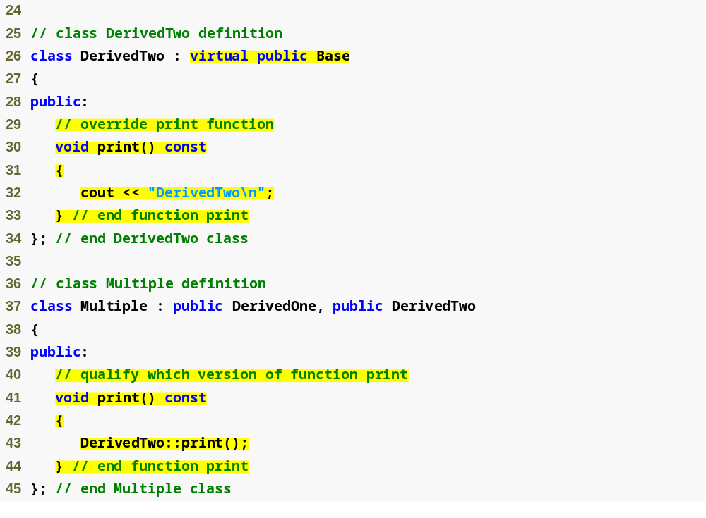
Class DerivedTwo uses virtual inheritance to inherit from class Base
Outline
fig25_14.cpp
(2 of 3)
Only one subobject of type Base is inherited into class Multiple

Slide 55
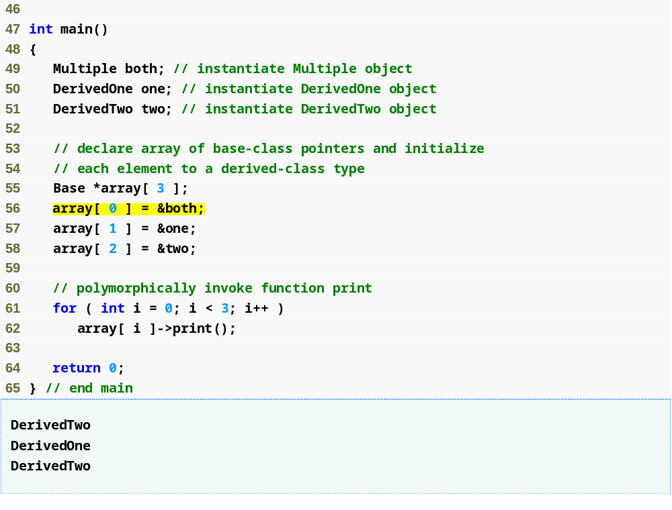
Outline
fig25_14.cpp
(3 of 3)
The compiler now allows the assignment of &both to array[ 0 ]

Slide 56
Software Engineering Observation 25.5
Providing a default constructor for virtual base classes simplifies hierarchy design.

Slide 57
25.8 Multiple Inheritance and virtual Base Classes (Cont.)
Additional information on multiple inheritance can be found in our C++ Resource Center
  www.deitel.dcom/cplusplus/

